Slide 1




Deep learning based Vehicle detection and speed estimation in traffic using videos
CHANNABASAVESHWARA INSTITUTE OF TECHNOLOGY,GUBBI,TUMKUR.
(Affiliated to VTU, Belagavi & Approved by AICTE, New Delhi)
(NAAC Accredited & ISO 9001:2015 certified institution) NH 206 (B H Road), Gubbi, Tumkur - 572216
Department of Computer Science and Engineering
2023-24
Presented by:-
Kusuma G (1CG20CS043)
Mohammed Afreed Ulla (1CG20CS055)
Mohammed Ashhad (1CG20CS056)
Mohammed Ibrahim (1CG20CS057)
Guide:-
Mrs. Lalitha Bandeppa, MTech
Asst. Prof., Dept. of CSE,
CIT, Gubbi, Tumakuru.

Slide 2
TABLE OF CONTENTS
Introduction
Problem Statement
Objectives
Scope of the Project
Literature Survey
Project Methodology
Result
Conclusion
Reference

Slide 3
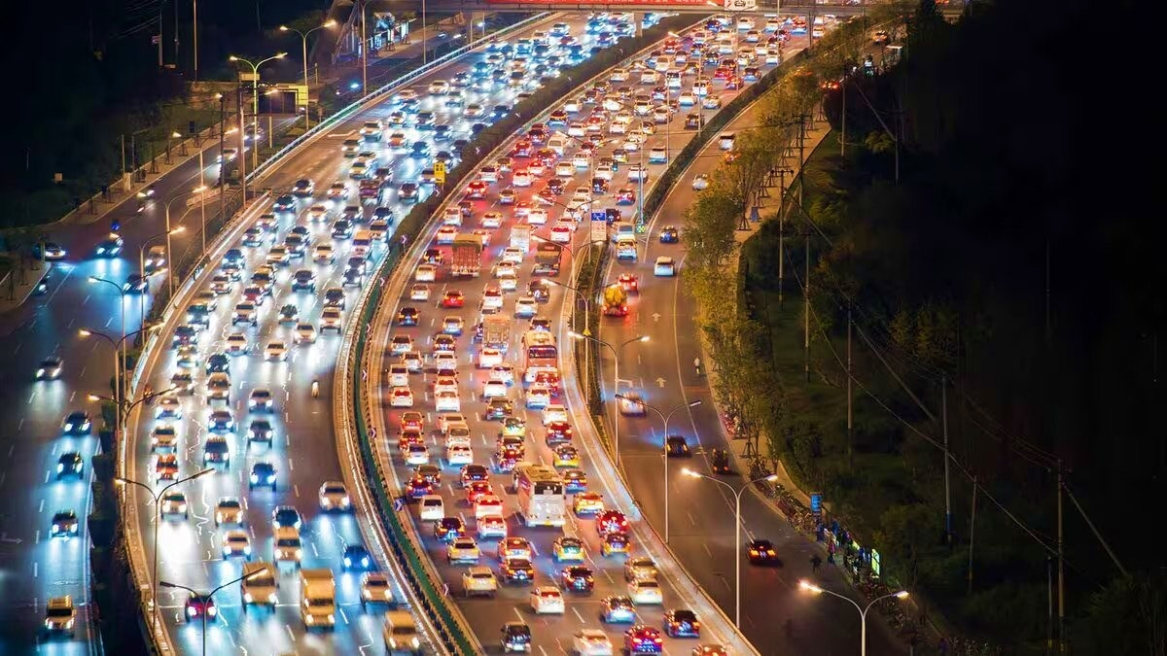
INTRODUCTION
The advancement of deep learning techniques has revolutionized various fields, including computer vision and transportation systems.
In this context, deep learning-based methods for vehicle detection and speed estimation using videos have emerged as powerful tools for enhancing traffic monitoring, surveillance, and overall road safety.
Real-time detection of vehicles allows for effective traffic monitoring, congestion analysis, and infrastructure planning.
Monitoring vehicle speeds can aid in enforcing speed limits and enhancing safety on roads.

Slide 4
PROBLEM STATEMENT
The need for accurate and real-time vehicle detection, coupled with precise speed estimation, is critical for enhancing safety measures. Existing methods often struggle to adapt to the dynamic nature of traffic, leading to limitations in accuracy, efficiency, and responsiveness.

Slide 5
OBJECTIVES
Designing and training a deep learning model capable of accurately detecting vehicles in videos.
Integrating speed estimation capabilities into the detection framework.
Counting of vehicles on the frame.

Slide 6
SCOPE OF THE PROJECT
Traffic Management System.
Road Safety.
Smart Cities.
Transportation Planning.
Automated Driving System.

Slide 7
LITERATURE REVIEW
Author(s) | Year | Methodology | Key Findings
Reddy et al. | 2020 | YOLOv8 for vehicle detection; Optical flow for speed estimation | Achieved real-time vehicle detection with high accuracy. Used optical flow for speed estimation, achieving reliable results in various traffic conditions.
Zhang et al. | 2021 | YOLOv8 with Kalman Filter for vehicle tracking; CNN for speed estimation | Proposed a hybrid approach combining YOLOv8 for vehicle detection and Kalman Filter for tracking. Used CNN-based speed estimation achieving robust results.
Wang and Liu | 2022 | YOLOv8 with Recurrent Neural Networks for speed estimation | Utilized YOLOv8 for vehicle detection and integrated Recurrent Neural Networks (RNNs) for speed estimation. Demonstrated improved accuracy compared to baseline methods.
Chen et al. | 2023 | YOLOv8 with data augmentation for robust detection; Regression for speed estimation | Employed YOLOv8 with extensive data augmentation techniques for improved detection accuracy. Applied regression models for speed estimation, achieving reliable results.
Li and Wu | 2024 | YOLOv8 with depth estimation for speed calculation | Proposed a method combining YOLOv8 with depth estimation techniques for more accurate speed calculation. Demonstrated enhanced performance in challenging scenarios.

Slide 8
Author(s) | Year | Methodology | Key Findings
Dr.PonHarshavardhanan | 2024 | The methodology involves loading the YOLOv8n model to detect objects in each frame, tracking their movement through bounding boxes, and estimating speed using consecutive frame analysis. | The study demonstrates the robustness and adaptability of the YOLOv8n model in accurately detecting vehicles and estimating their speeds.
Behnam Asadi | 2024 | The study utilizes real-time video data and applies YOLOv8 for initial detection followed by the use of DeepSORT for tracking. Speed estimation is performed by calculating the distance between consecutive detections and dividing by the time difference. | YOLOv8 outperforms other models in terms of detection accuracy and processing speed, making it highly suitable for real-time applications. The combination of YOLOv8 and DeepSORT enhances the system’s ability to track vehicles accurately and estimate their speeds, providing a reliable solution for traffic monitoring​
HerOeshouldDIE | 2024 | This project implements vehicle counting and speed estimation using the YOLOv8 model in a Python environment. | The implemented system successfully detects vehicles and estimates their speeds in video sequences. The study highlights the efficiency of YOLOv8 in providing accurate vehicle counts and speed measurements, emphasizing its potential for use in traffic management and smart city applications​

Slide 9
PROJECT METHODOLOGY
Traffic Videos
Frame Extraction
Model (Yolov8)
Vehicle Detection
Speed Estimation
Real-World Deployment
Model Training
Evaluation

Slide 10

Methodology Details
Traffic Videos:- Video Datasets: Gathering diverse video datasets containing traffic scenes captured from different perspectives (e.g., cameras mounted on roads,or surveillance systems).
Deep Learning Model (Yolov8):-YOLOv8 for vehicle detection would require expertise in deep learning, computer vision, and data preprocessing.
Vehicle Detection:- Implementing techniques for vehicle localization within video frames, including bounding box prediction and object tracking across frames.
Speed Estimation:- Estimation of Speed using two points (i.e) Initial Point and Final Point by using speed formula.
Speed$=\frac{Distance}{Time}$ x 3.6

Slide 11
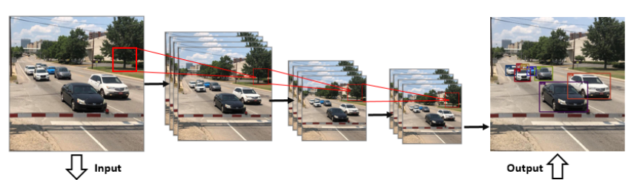
Yolov8
Input Image
Backbone Network
Feature Pyramid
Detection Head
Output Layer

Slide 12

Speed estimation
Speed$=\frac{Distance}{Time}$ x 3.6

Slide 13
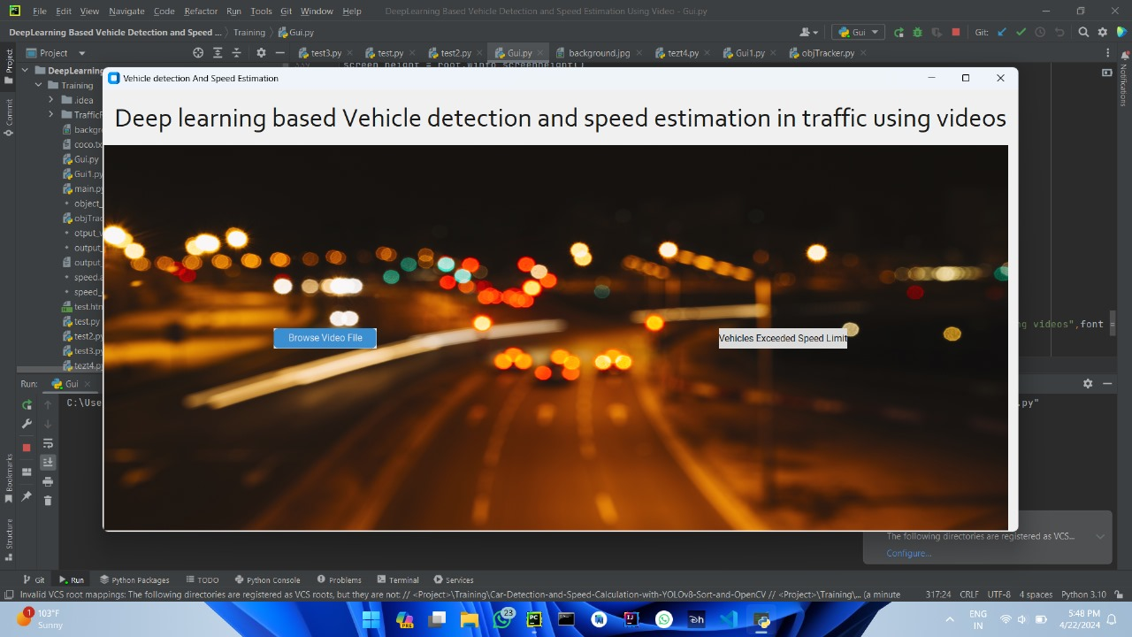
RESULTS
Initial User Interface

Slide 14
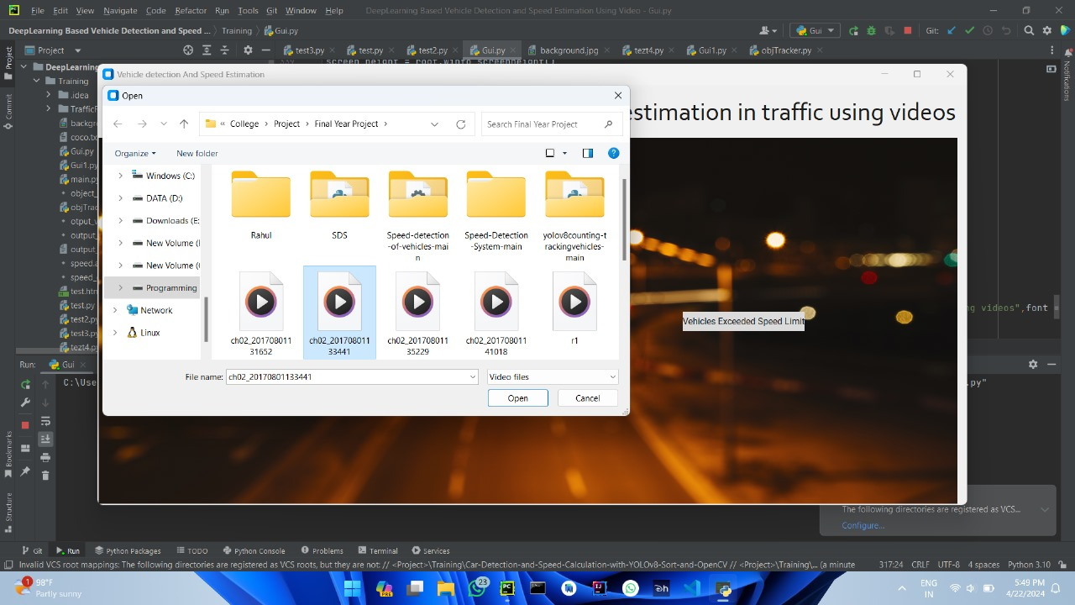
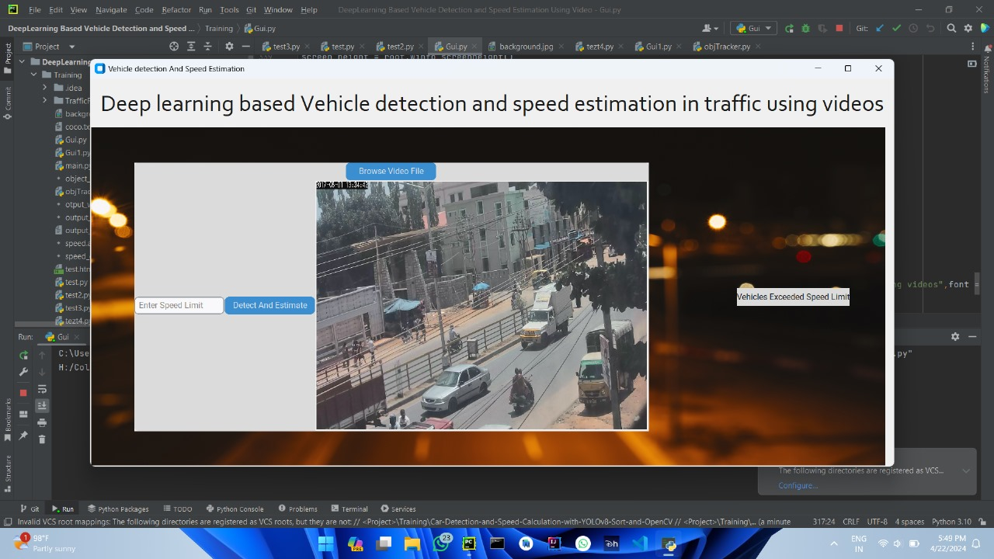
RESULTS CONT…
Browsing the video file
Preview of Selected video file

Slide 15
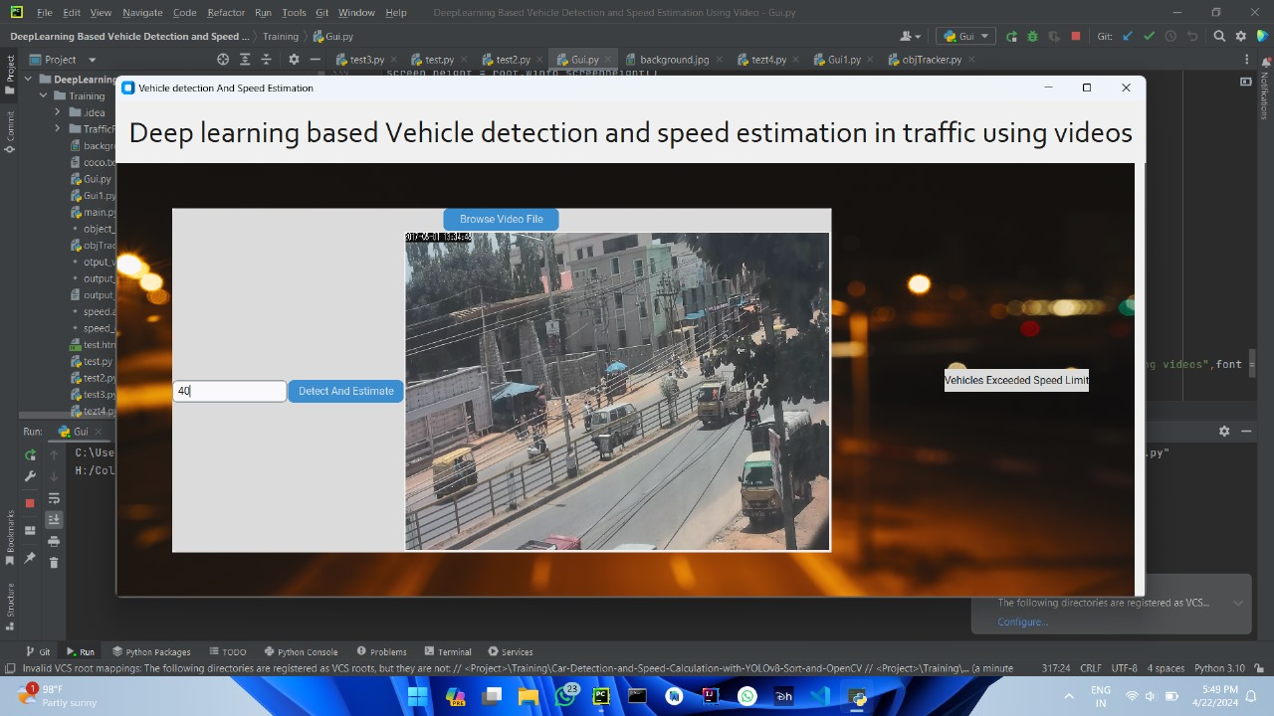
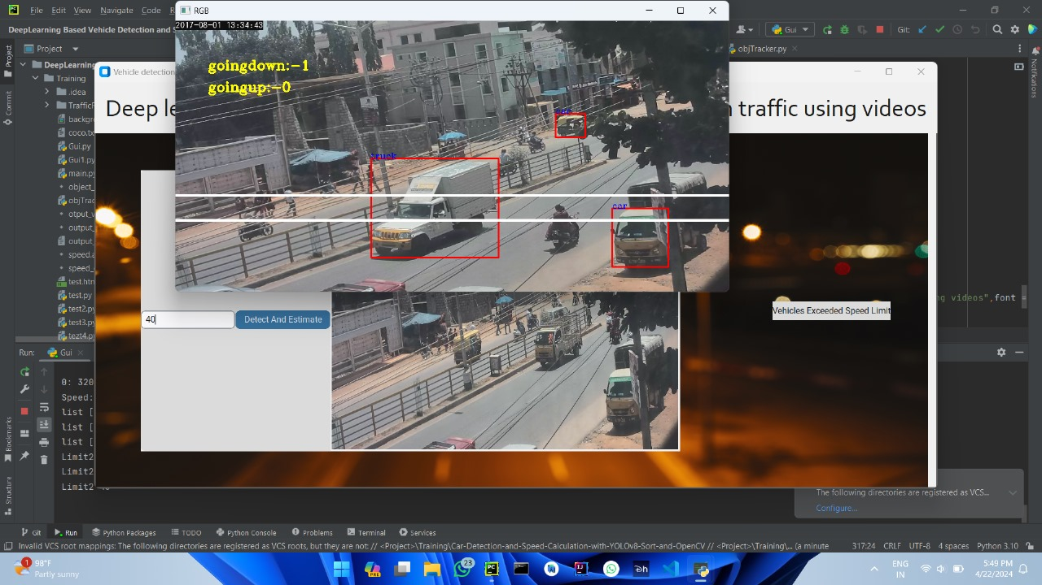
RESULTS CONT…
Giving the speed limit
Vehicle detection

Slide 16
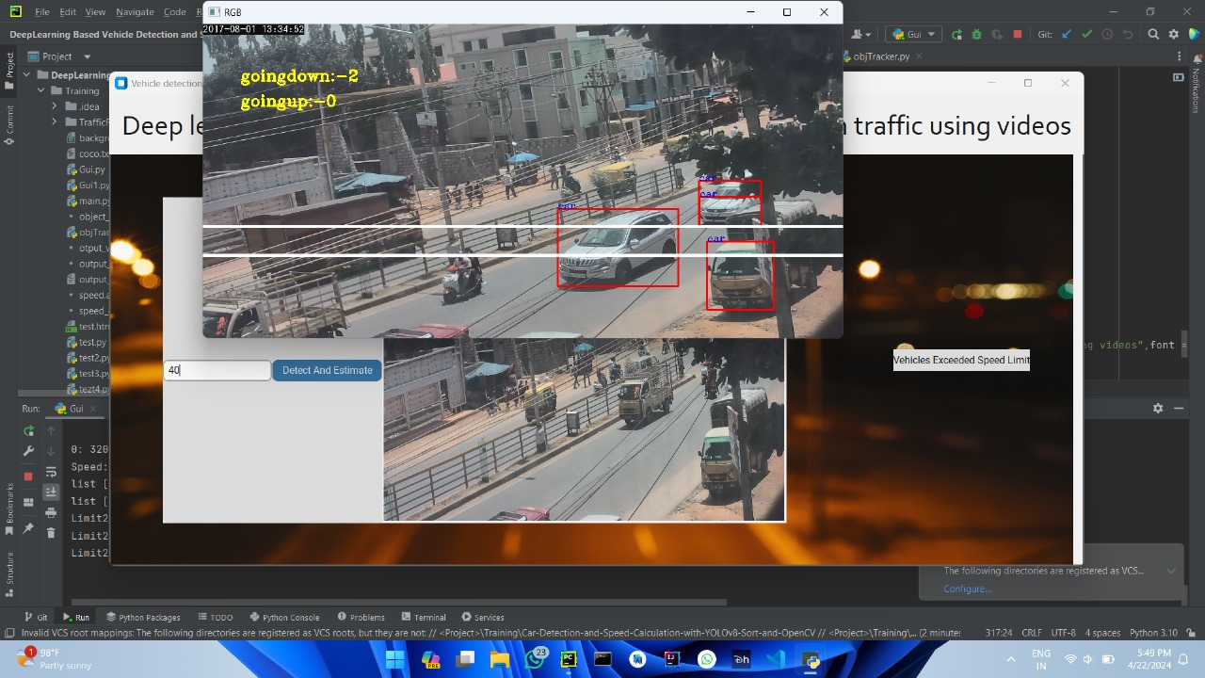
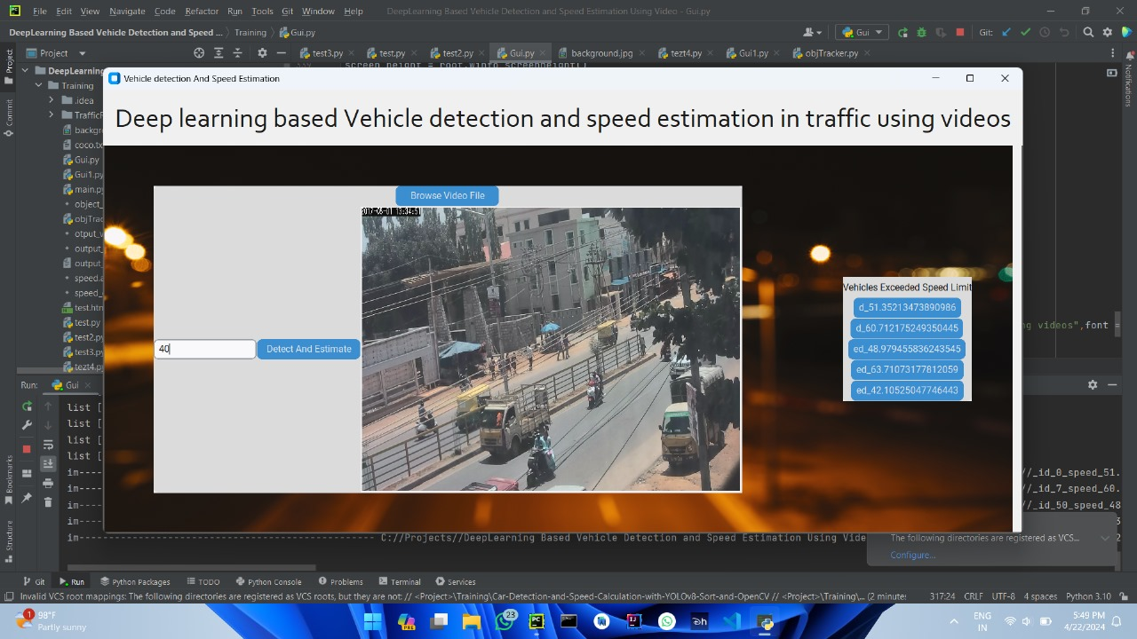
RESULTS CONT…
Speed Estimation of Vehicle
List of vehicles that exceeded speed limit

Slide 17
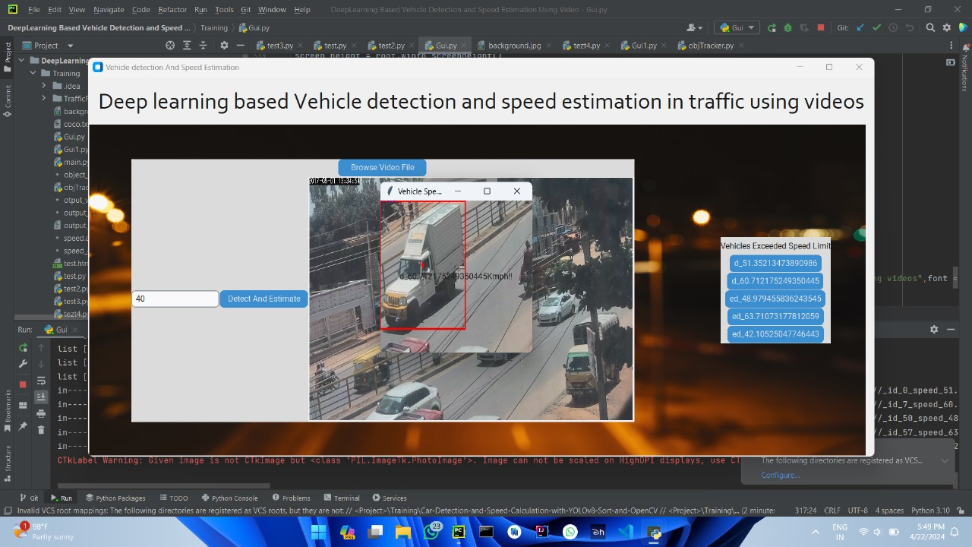
RESULTS CONT…
Snapshot of speed exceeded vehicle

Slide 18
CONCLUSION
In conclusion, the deep learning-based vehicle detection and speed estimation system developed in this project demonstrates promising results in accurately identifying vehicles and estimating their speeds from video data.
By leveraging state-of-the-art techniques, the system offers enhanced capabilities for traffic monitoring and management.
The successful implementation and evaluation of the system pave the way for further advancements in intelligent transportation systems, contributing to improved traffic safety and efficiency.

Slide 19
REFERENCES
S. Hochreiter and J. Schmidhuber, ―Long short-term memory,‖ Neural Computation, vol. 9, no. 8, pp. 1735–1780, Nov. 1997.
Y. Bengio, P. Simard, and P. Frasconi, ―Learning long-term dependencies with gradient descent is difficult,‖ Neural Networks, IEEE Transactions on, vol. 5, no. 2, pp. 157–166, 1994.
S. Wang, L. Yu, & K.K. Lai, ―Crude Oil Price Forecasting With TEI@I Methodology‖ Journal of Systems Science and Complexity, vol. 18, no. 2, 2005, pp. 145-166.
Kulkarni, S. and Haidar, I. (2009). Forecasting Model for Crude Oil Price Using Artificial Neural Networks and Commodity Futures Prices. International Journal of Computer Science and Information Security, 2(1).
S. Moshiri, and F. Foroutan, ―Forecasting nonlinear crude oil futures prices,‖ The Energy Journal vol. 27, pp. 81-95, 2005.

Slide 20
REFERENCES
L. Yu, S. Wang & K.K. Lai, ―Forecasting crude oil price with an EMD-based neural network ensemble learning paradigm ‖ Energy Economics, vol. 30, no. 5, 2008, pp. 2623-2635.
Liu, J., Bai, Y., and Li, B. (2007). A New Approach to Forecast Crude Oil Price Based on Fuzzy Neural Network. In Fourth International Conference on Fuzzy Systems and Knowledge Discovery (FSKD 2007), Vol. 3, pages 273–277. IEEE.
C. Morana, ―A Semiparametric Approach to Short-term Oil Price Forecasting,‖ Energy Economics, vol. 23, 2001, pp. 325-338.
M. Ye, J. Zyren, & J. Shore, ―A Monthly Crude Oil Price Forecasting Model Using Relative Inventories,‖ International Journal of Forecasting, vol. 21, 2005, pp. 491- 501.
L. Yu, S. Wang & K.K. Lai, ―A Rough-Set-Refined Text Mining Approach for Crude Oil Market Tendency Forecasting,‖ International Journal of Knowledge and Systems Sciences, vol. 2, no. 1, 2005.

Slide 21
THANK
YOU

